Slide 1
Image Captioning
Калоян Спиридонов
Елена Захариева

Slide 2
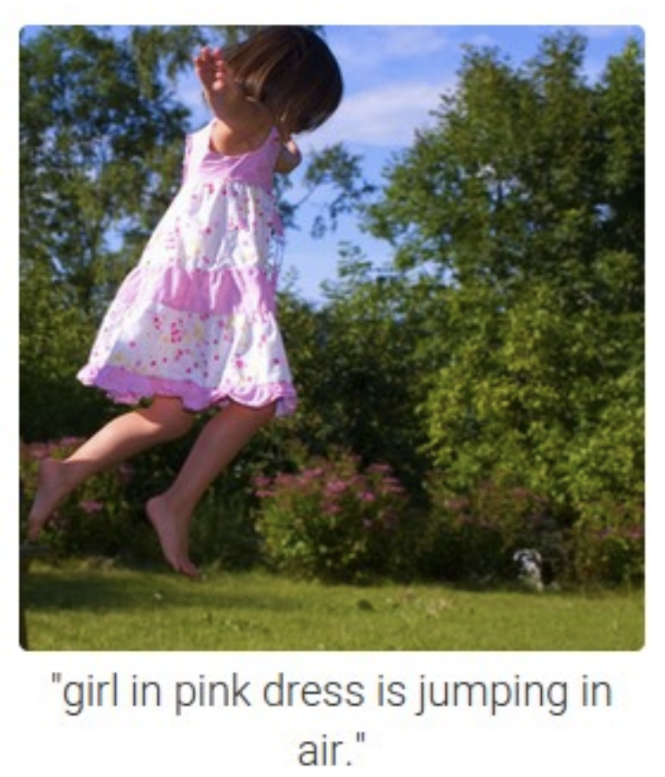
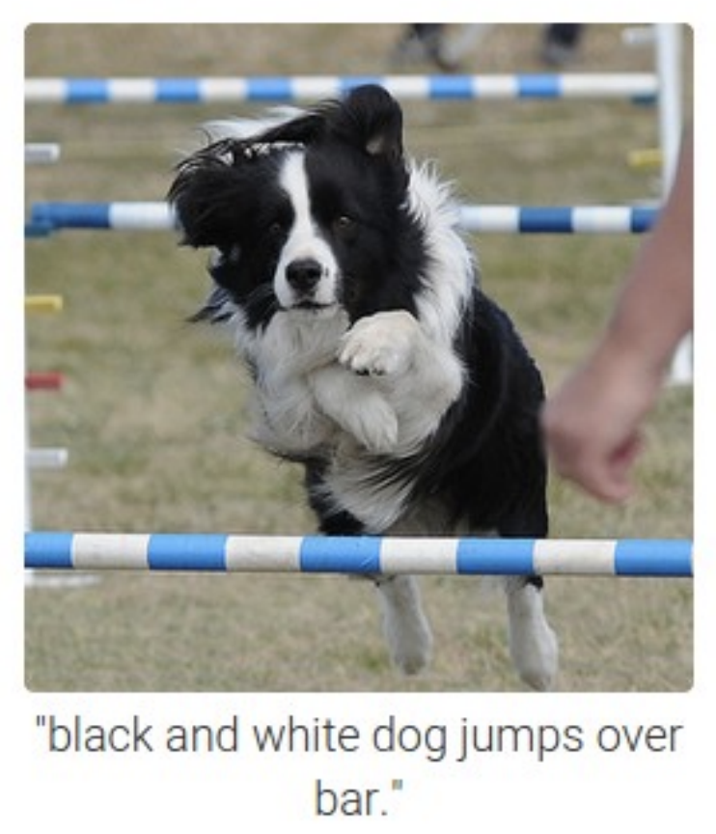
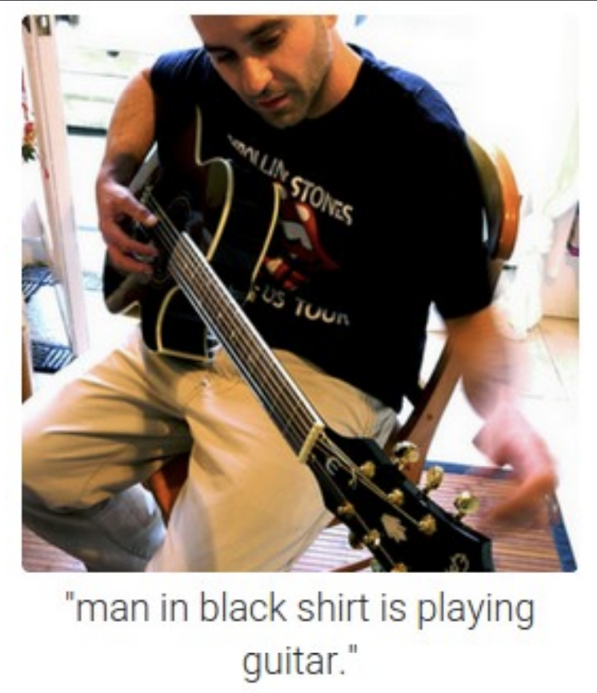
What is Image captioning?

Slide 3
Dataset – FLICKr8k
Train data – 6000
Test data – 1000
Validation data – 1000
Boys are playing soccer .
Two boys soccer teams play , one boy goes after the ball .
Two teams of boys playing soccer .
The soccer player in the checked shirt is moving the ball pursued by the players on the other team .
A group of young soccer players run down the field after the ball .

Slide 4
Captions preprocessing
Split to words
All words to lowercase
Remove punctuation
Use keras tokenizer
max caption length = 34

Slide 5
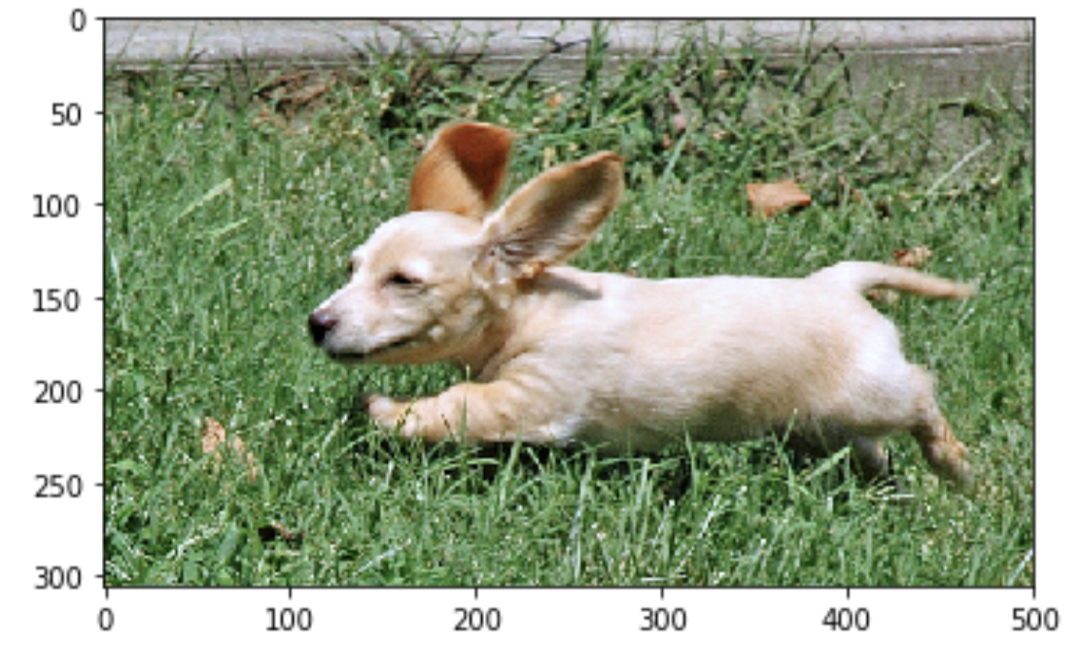
Model
CONCAT
CNN
DENSE
DENSE
DENSE
brown dog is ?
EMBEDDING
LSTM
running
BLEU-1: 0.555860
BLEU-2: 0.279278
BLEU-3: 0.180292
BLEU-4: 0.077575

Slide 6
Model
CONCAT
CNN
DENSE
DENSE
DENSE
brown dog is ?
EMBEDDING
LSTM
LSTM
running
# BLEU-1: 0.543121
# BLEU-2: 0.301569
# BLEU-3: 0.209945
# BLEU-4: 0.099759

Slide 7

Model
CONCAT
CNN
DENSE
REPEAT VECTOR
LSTM
DENSE
brown dog is ?
EMBEDDING
LSTM
running
BLEU-1: 0.577624 +0.0217
BLEU-2: 0.334999 +0.0557
BLEU-3: 0.232525 +0.0522
BLEU-4: 0.112670 +0.0350

Slide 8
Model
CONCAT
CNN
DENSE
REPEAT VECTOR
ATTENTION LAYER
LSTM
DENSE
brown dog is ?
EMBEDDING
LSTM
running
BLEU-1: 0.576892 -0.000732
BLEU-2: 0.330481 -0.004518
BLEU-3: 0.235706 +0.003181
BLEU-4: 0.118113 +0.005443

Slide 9
OBSERVATIONS
BLEU SCORE
7579 words in train set
3176 words in test set
____________________
542 in test set but not in train set

Slide 10
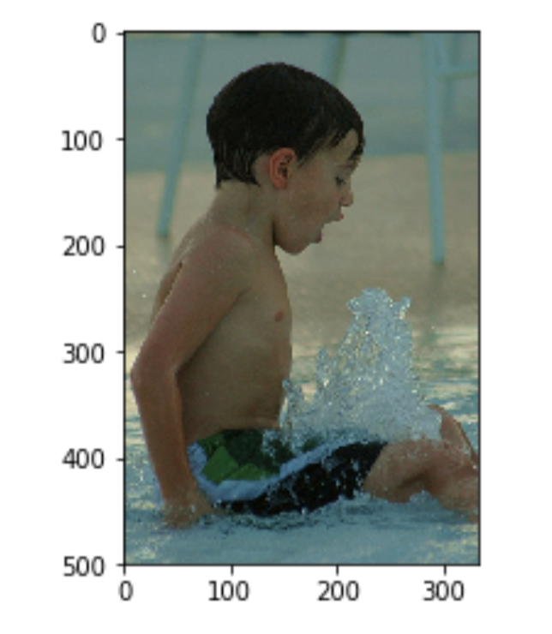
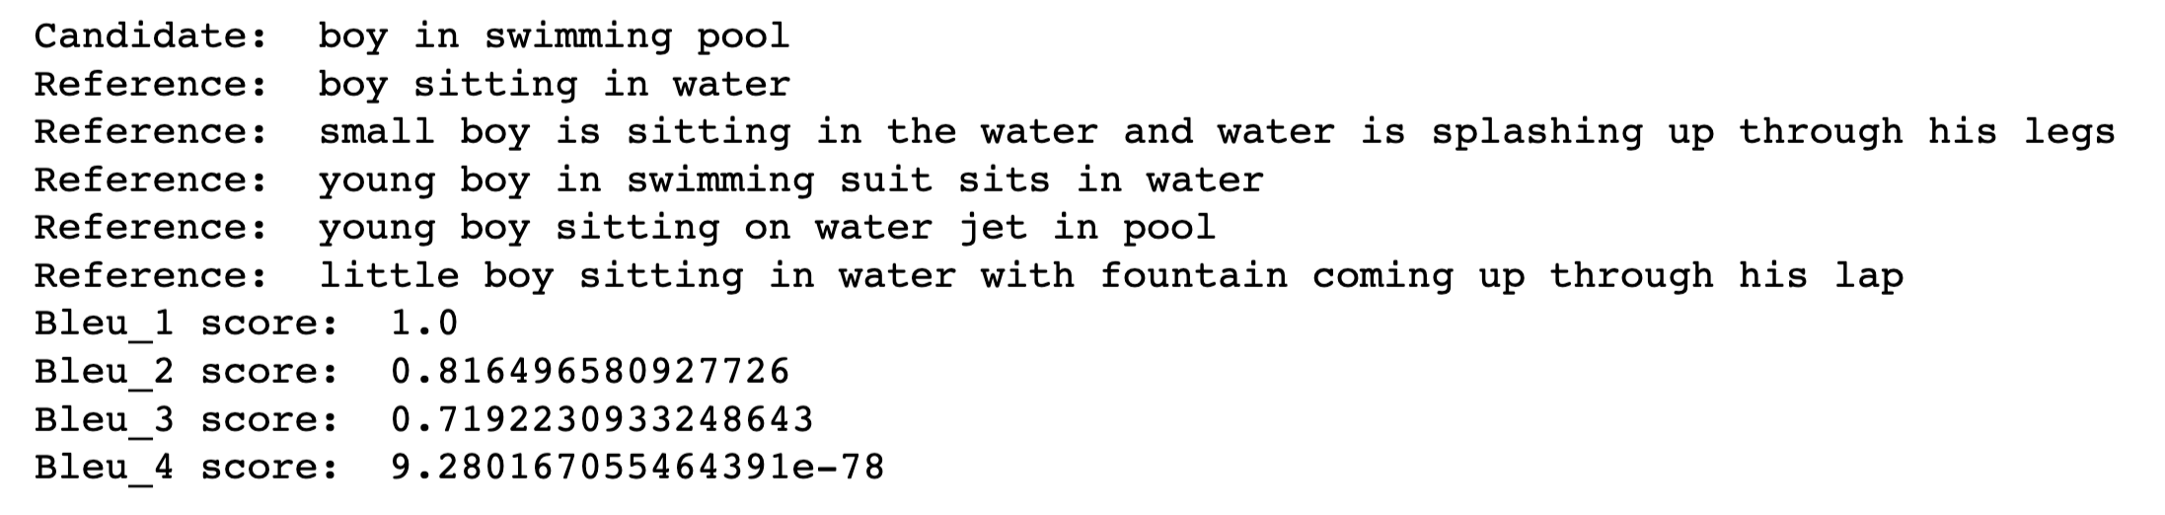
OBSERVATIONS

Slide 11
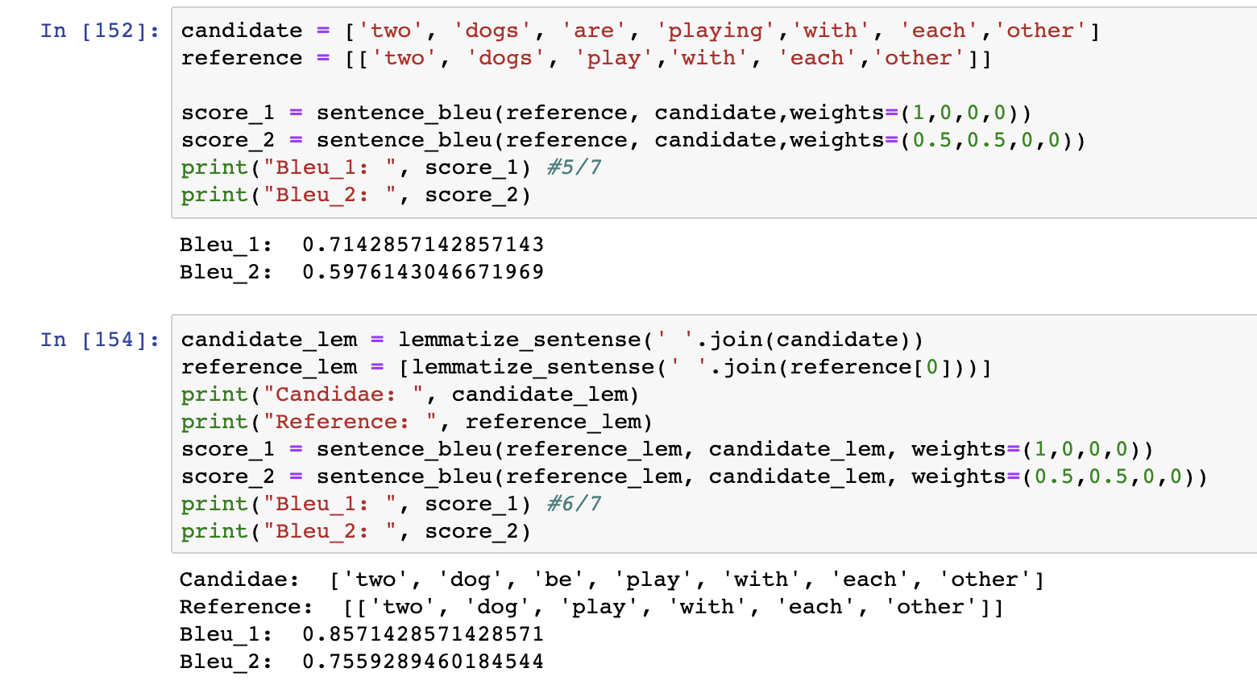
OBSERVATIONS

Slide 12
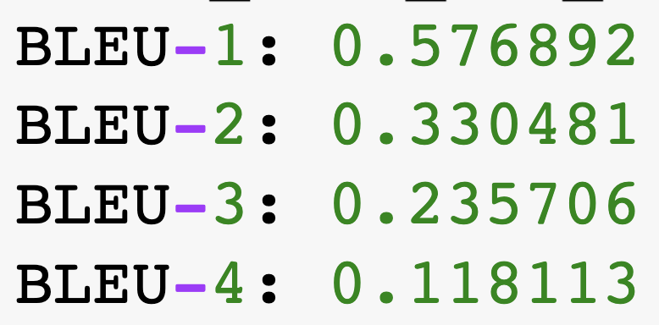
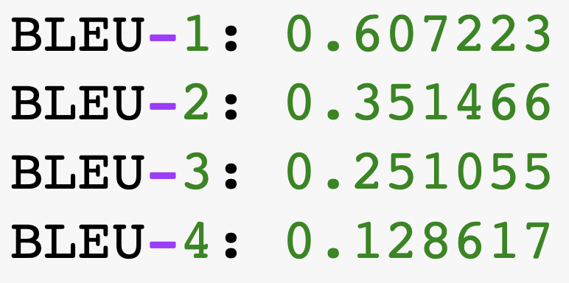
OBSERVATIONS
Normal
Lemmatized

